Slide 1


AIL 411-DEEP LEARNING LAB
PREPARED BY: Asha Rose Thomas
AP,CSE(AI),ASIET,Kalady

Slide 2
EXPERIMENT 9
Implement time series forecasting prediction for NIFTY-50 dataset

Slide 3
NIFTY-50 dataset
NIFTY 50 Overview:
Benchmark Indian stock market index.
Represents the weighted average of 50 of the largest Indian companies listed on the National Stock Exchange (NSE).
One of the two main stock indices in India, alongside the BSE SENSEX.
Data Description:
Content:
Price history and trading volumes of the fifty stocks in the NIFTY 50 index.
Source:
National Stock Exchange (NSE) India.
Granularity:
Day-level data.
Format:
Split across .csv files for each stock.
Includes a metadata file with macro-information about the stocks.
Time Span:
From 1st January, 2000 to 30th April, 2021.

Slide 4
NIFTY-50 dataset
NIFTY 50 Overview:
Benchmark Indian stock market index.
Represents the weighted average of 50 of the largest Indian companies listed on the National Stock Exchange (NSE).
One of the two main stock indices in India, alongside the BSE SENSEX.
Data Description:
Content:
Price history and trading volumes of the fifty stocks in the NIFTY 50 index.
Source:
National Stock Exchange (NSE) India.
Granularity:
Day-level data.
Format:
Split across .csv files for each stock.
Includes a metadata file with macro-information about the stocks.
Time Span:
From 1st January, 2000 to 30th April, 2021.

Slide 5
Dataset features
The Date - Trading day
Symbol - Stock Name
Prev Close - Closing price of the stock on previous day
Open - Openning Price on the given day
High - Highest Price on the given day
Low - Lowest Price on the given day
Last - Last Price on the given day
Close - Closing Price on the given day
VWAP - Average price on the stock traded througout the day

Slide 6
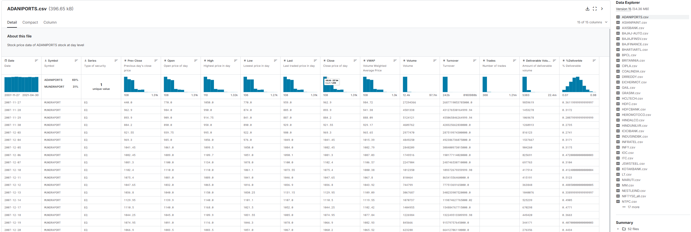
Sample details of the dataset

Slide 7
Time series data
Key Components:
Trend: Long-term movement in the data.
Seasonality: Regular pattern repeating over a specific period.
Cyclical: Long-term fluctuations influenced by economic or business cycles.
Applications:
Finance: Stock prices, economic indicators.
Retail: Sales forecasting, inventory management.
Weather: Temperature, precipitation patterns.
Analysis
Forecasting: Predict future values based on past trends.
Anomaly Detection: Identify unusual patterns or outliers.
A sequence of data points collected or recorded at successive points in time, typically at uniform intervals.

Slide 8
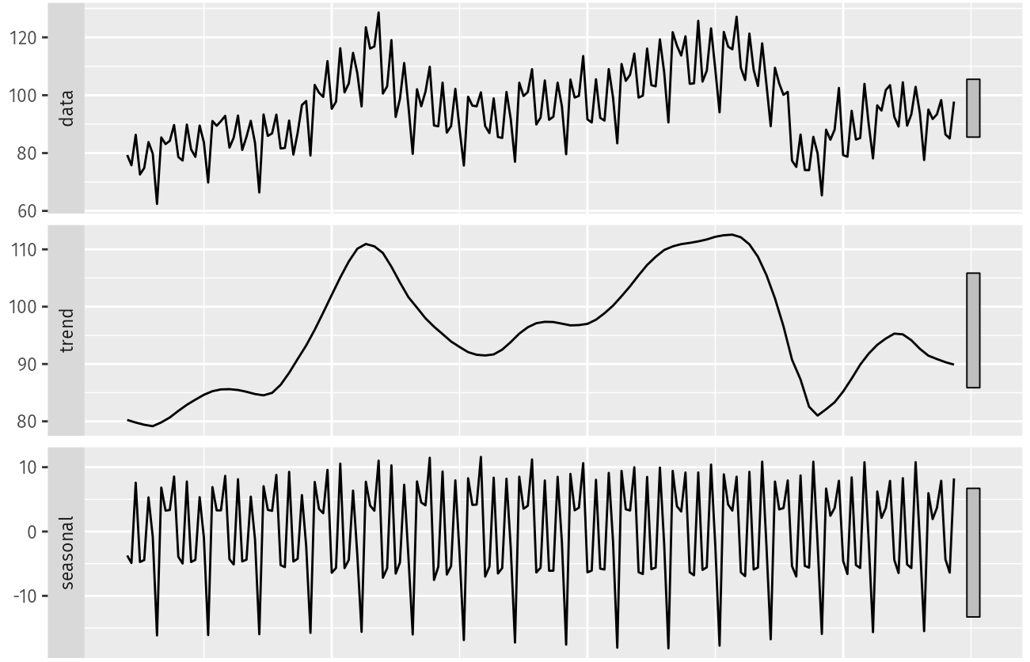
Time series components

Slide 9
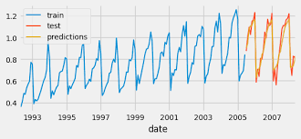
Time series forecasting

Slide 10
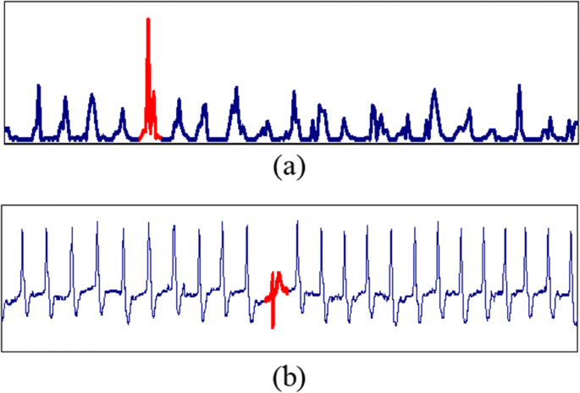
Time series Anomaly detection

Slide 11
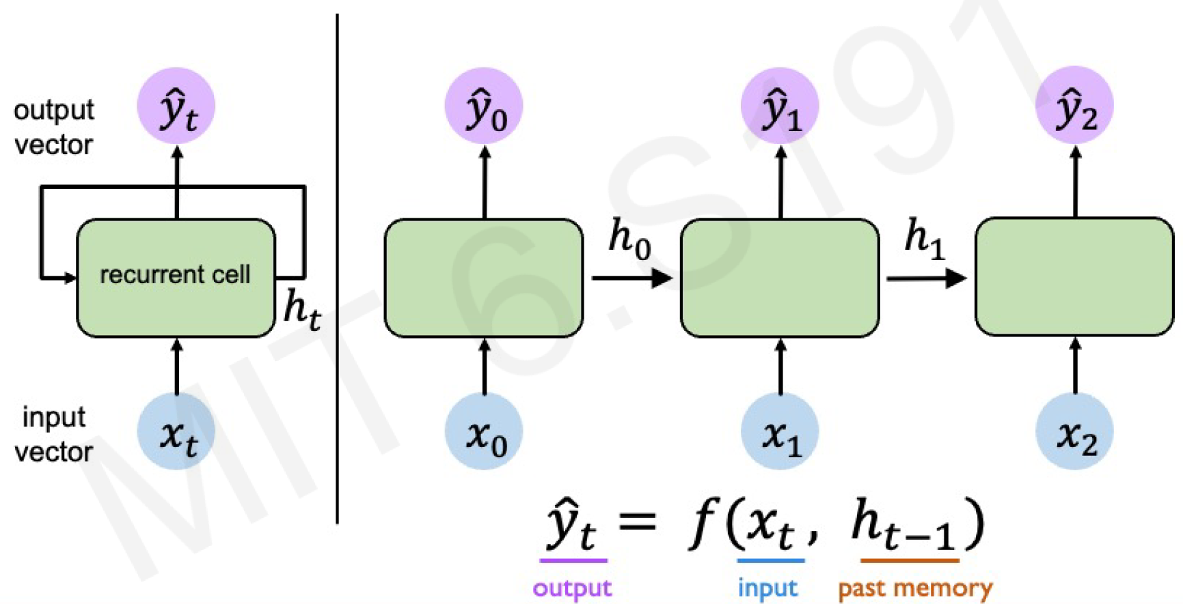
RNN - add immediate past to the present

Slide 12
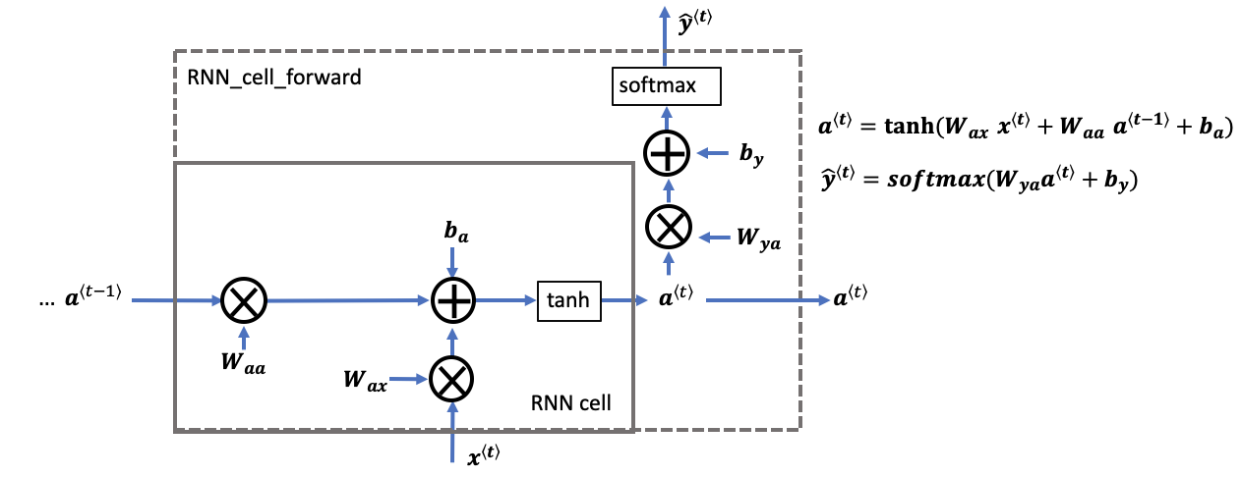
RNN Cell

Slide 13
Reference
Time-series-analysis-project/lstm-rnn-arimax-ar-models-and-analysis.ipynb at main · ds-brx/Time-series-analysis-project · GitHub
NIFTY-50 Stock Market Data (2000 - 2021) (kaggle.com)

